Slide 1
Background
This week we’re looking at two papers that are related in that they both have evaluation implications. The first looks carries over from our adversarial evaluation week. One of the issues with adversarial evaluation was that adversarial samples weren’t guaranteed to be grammatically correct or make sense- especially as sentences get longer. This first paper uses VAEs to create latent representations that allow smooth, and well-formed sentences that interpolate between known sentences. This could be used for imputing, augmenting, or possibly in adversarial evaluation. The second paper is from emnlp 2021. It looks at the use of models trained on GLUE benchmarks as a proxy for human dialogue system evaluation

Slide 2
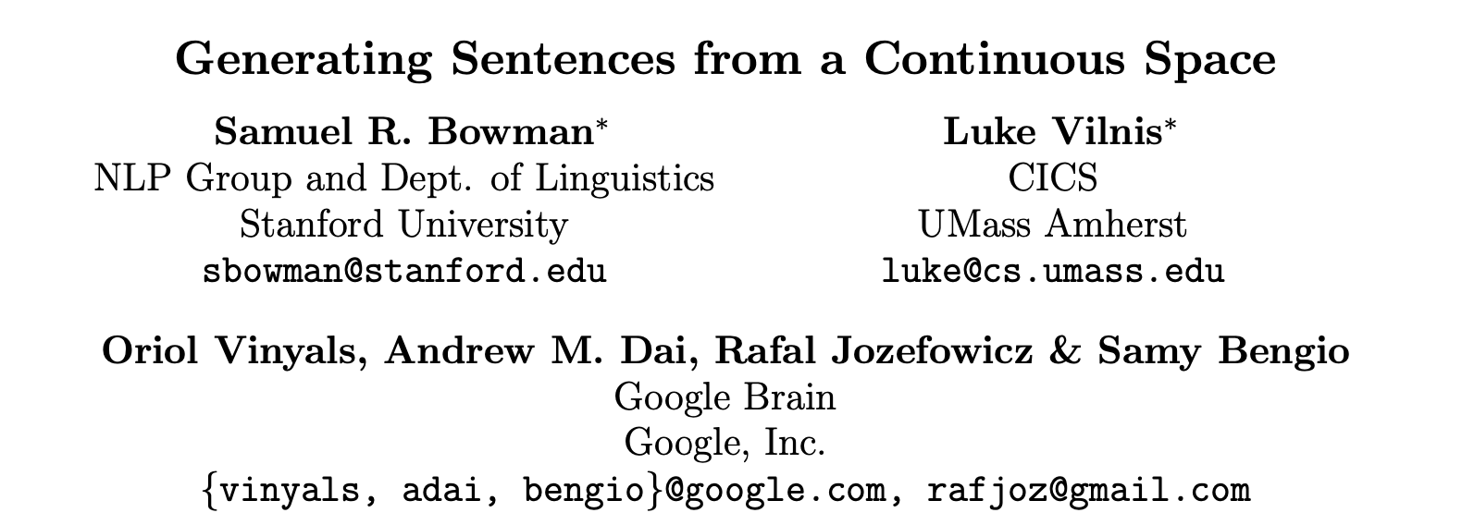

Slide 3
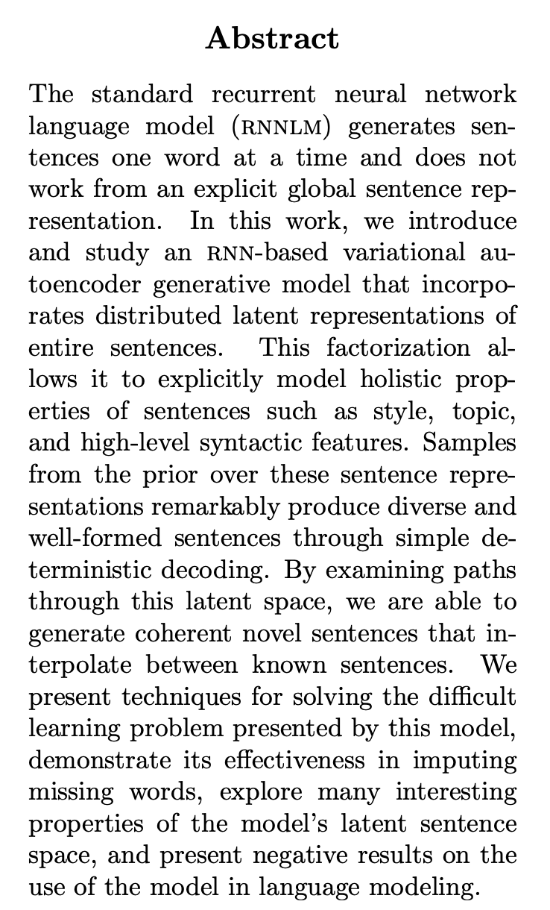

Slide 4


Slide 5
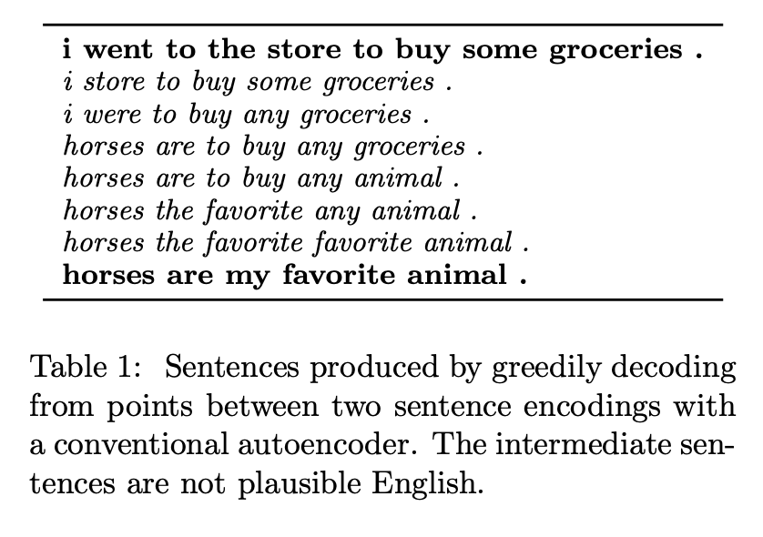

Slide 6
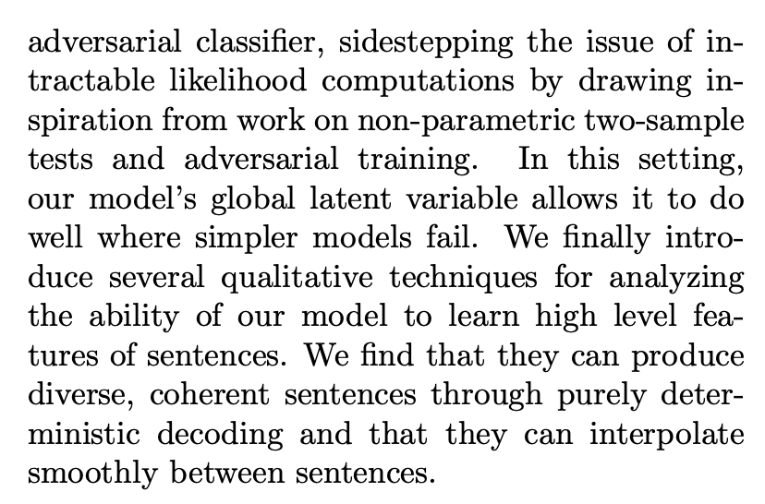
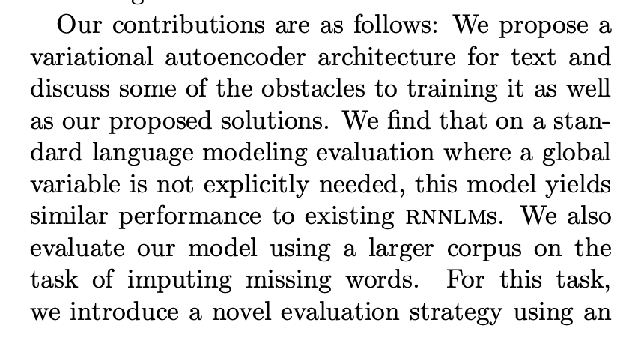

Slide 7
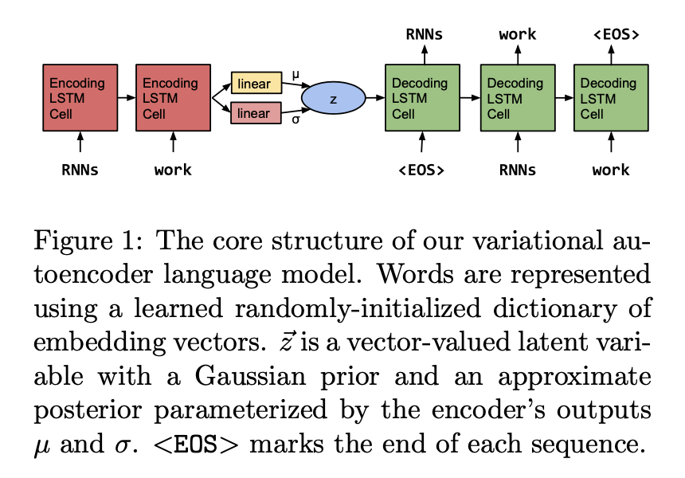
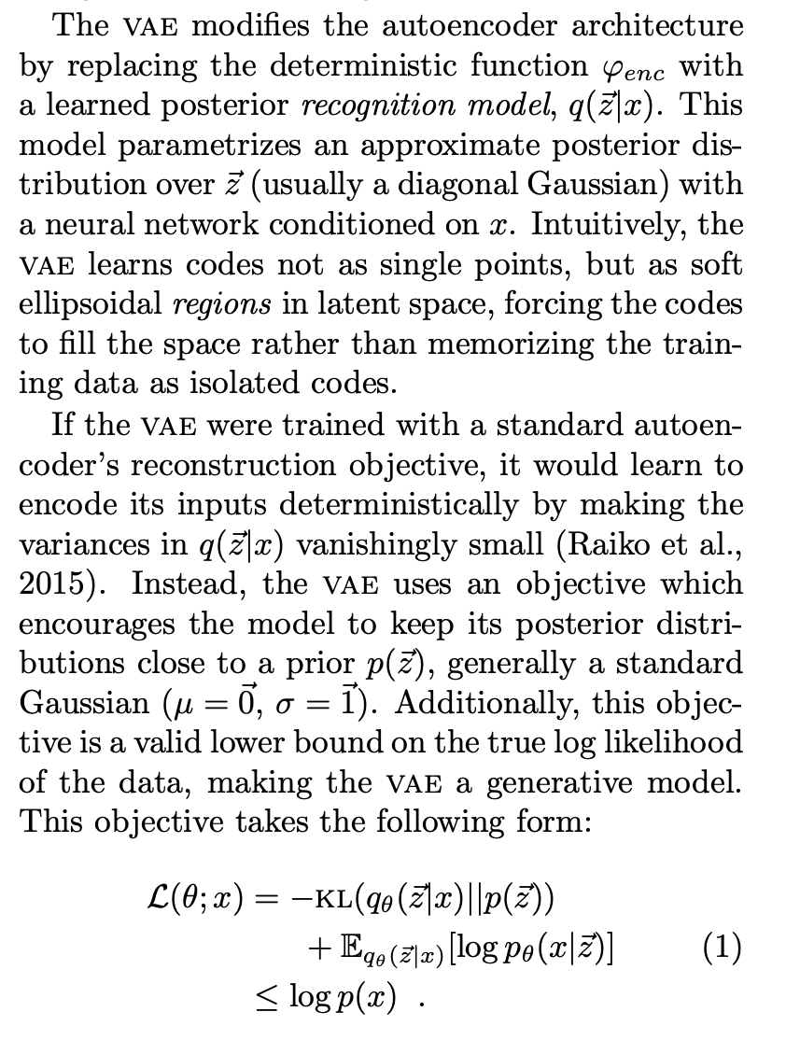

Slide 8
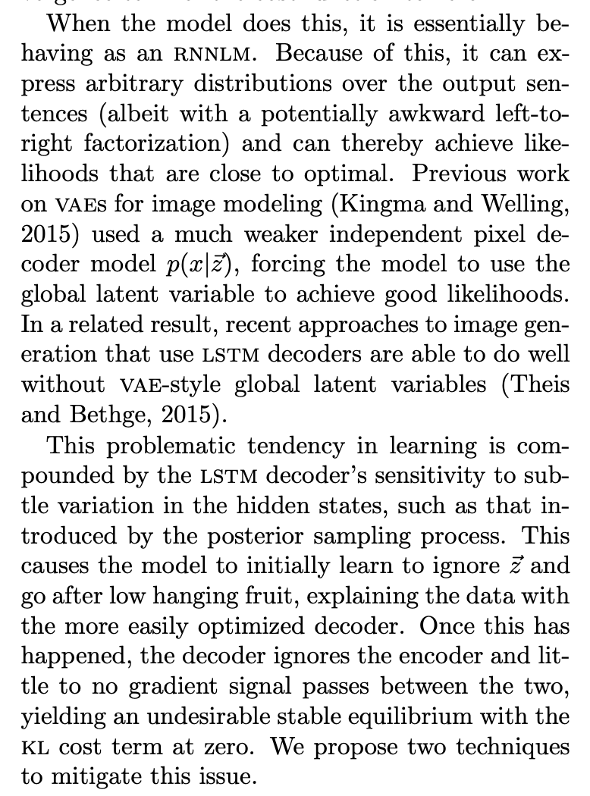
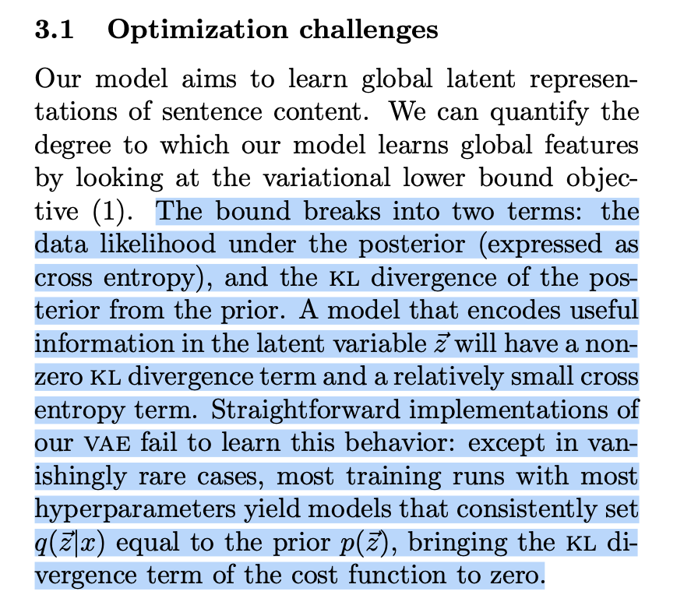

Slide 9
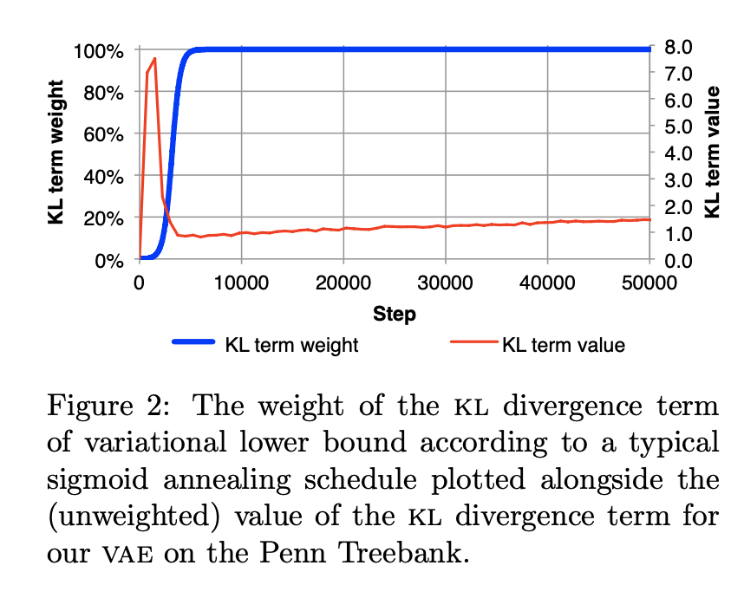

Slide 10
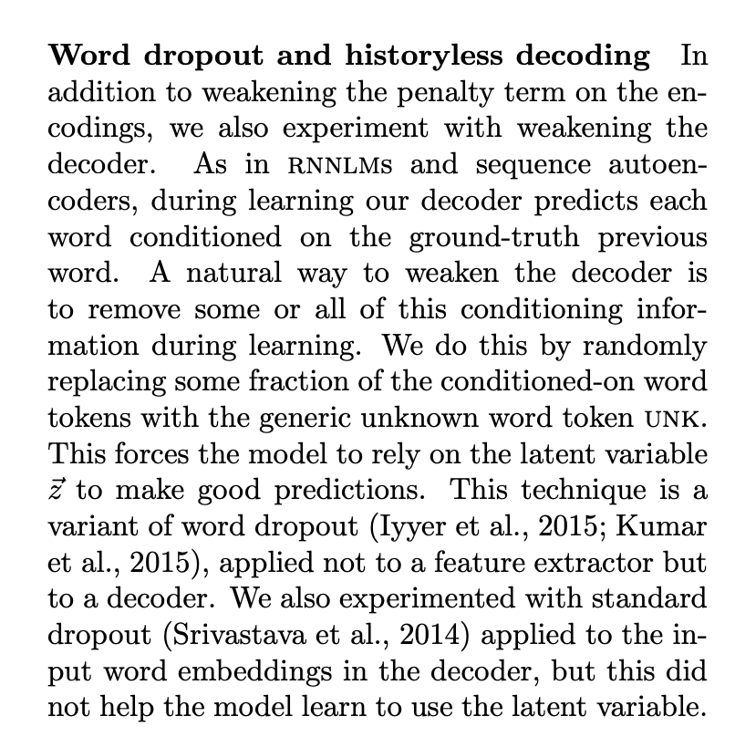

Slide 11
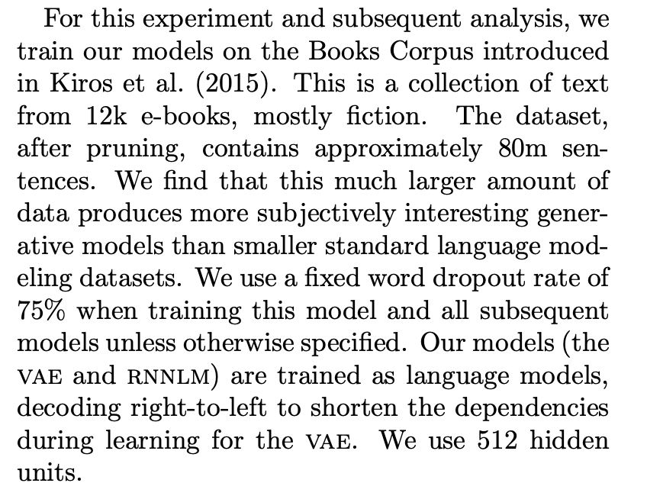

Slide 12
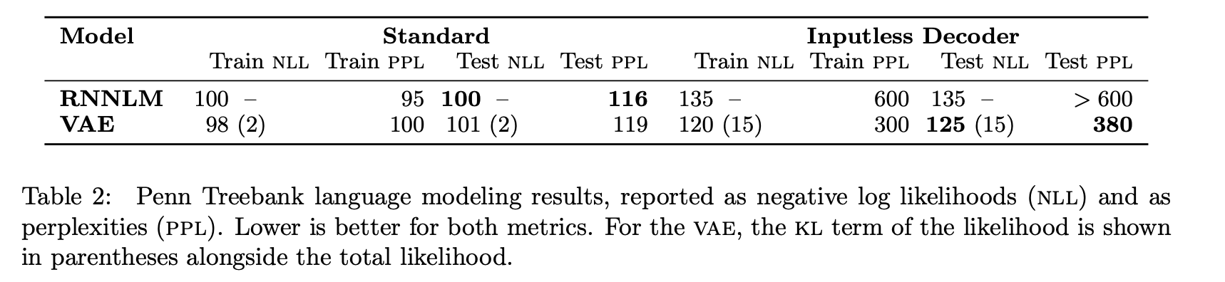

Slide 13
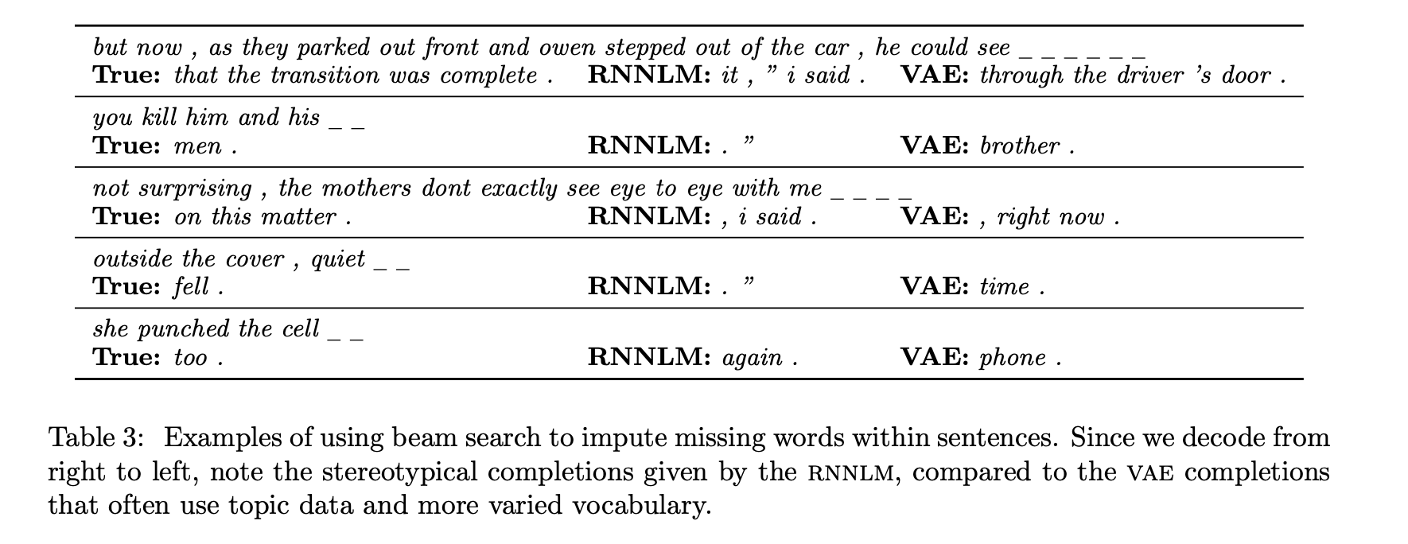

Slide 14
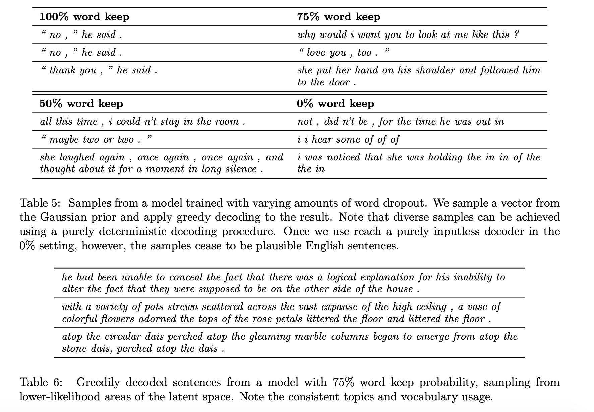

Slide 15
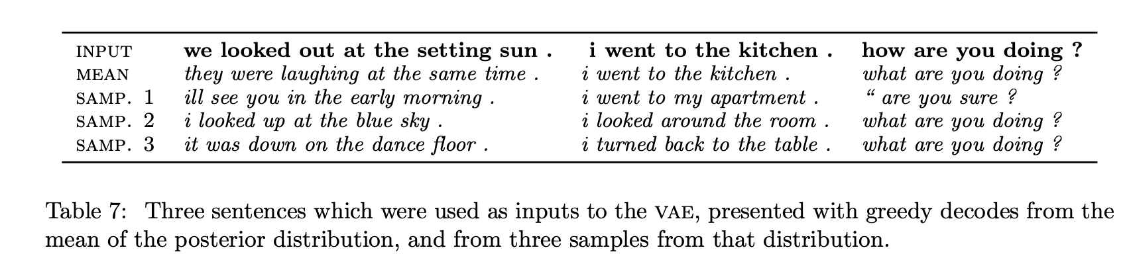

Slide 16
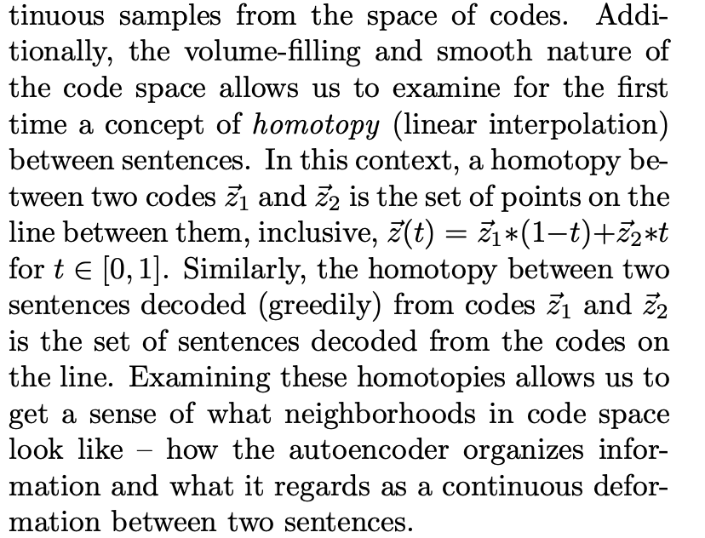

Slide 17
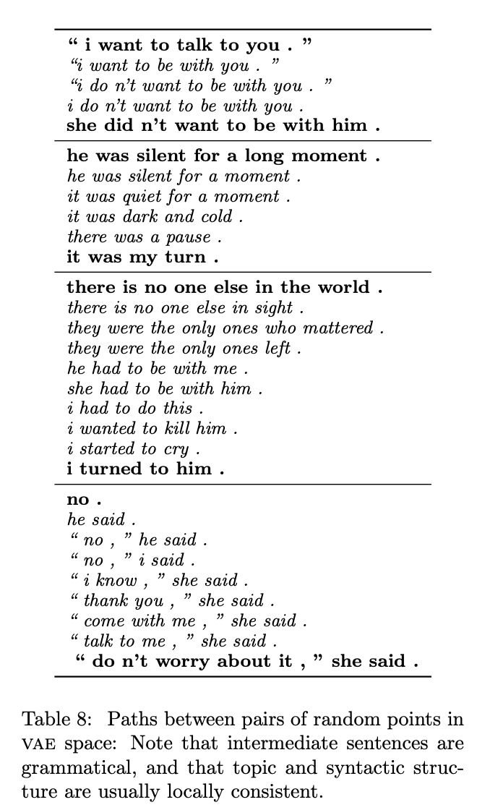

Slide 18
Synthesis
Really interesting paper. I’ve never thought about interpolating between two sentences before, and I’m really impressed at the results they showed. The authors propose that this could be a tool for imputation, but I think it would be a really cool tool for data augmentation. Data imbalance is a big problem for nlp modeling, I’d love to try this on, for example, a set of fake news tweets and see if the augmentations make sense.

Slide 19
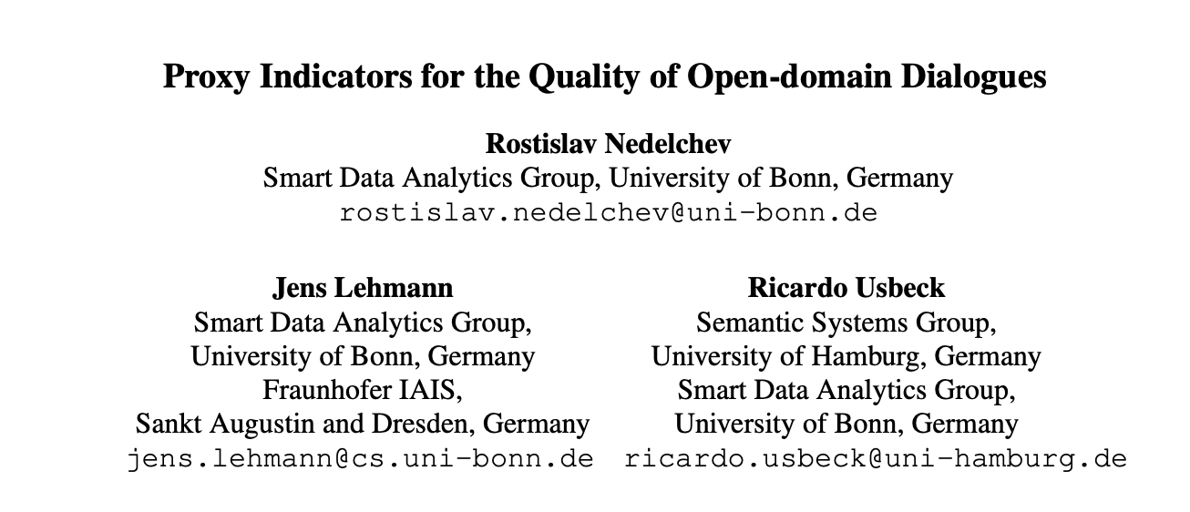

Slide 20
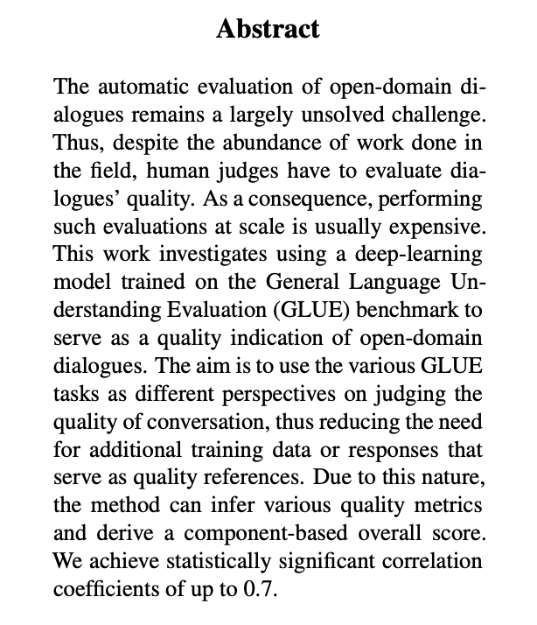
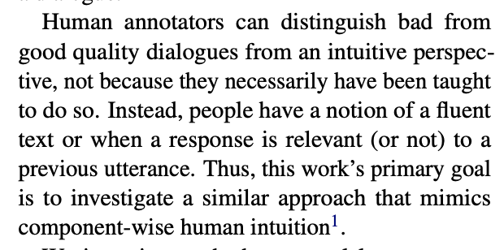

Slide 21
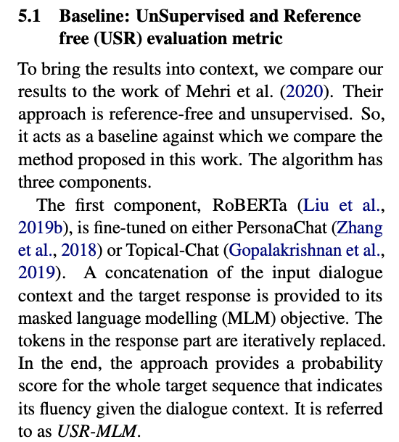
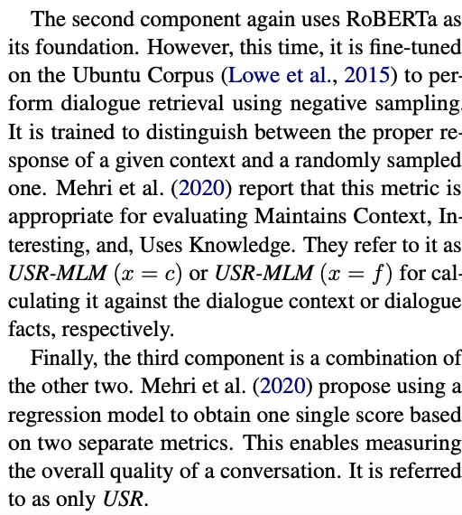

Slide 22
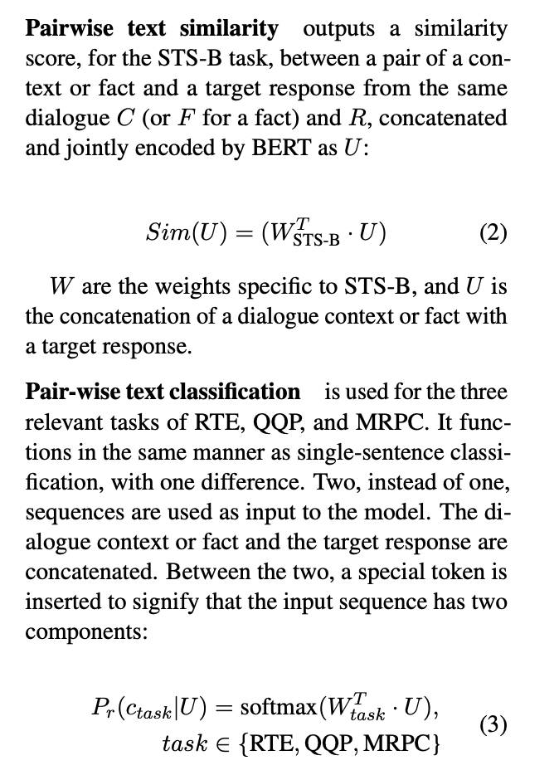
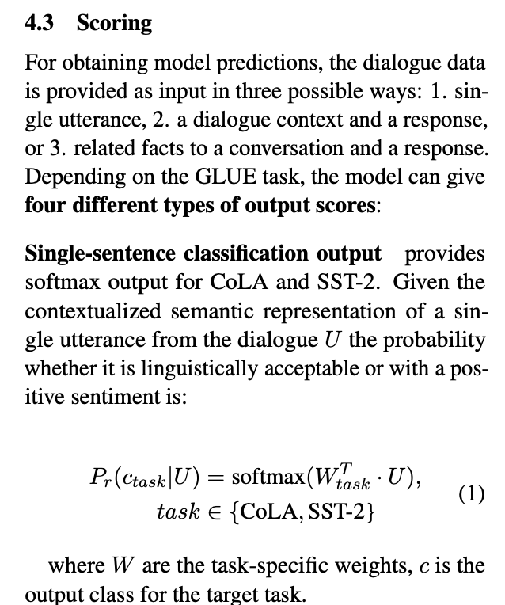

Slide 23
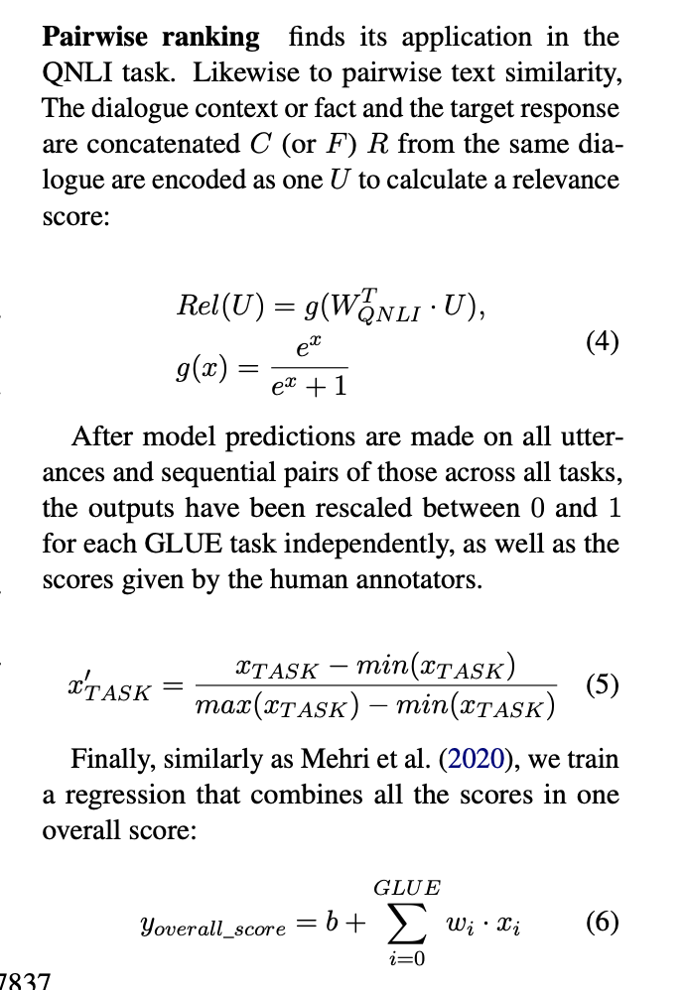

Slide 24
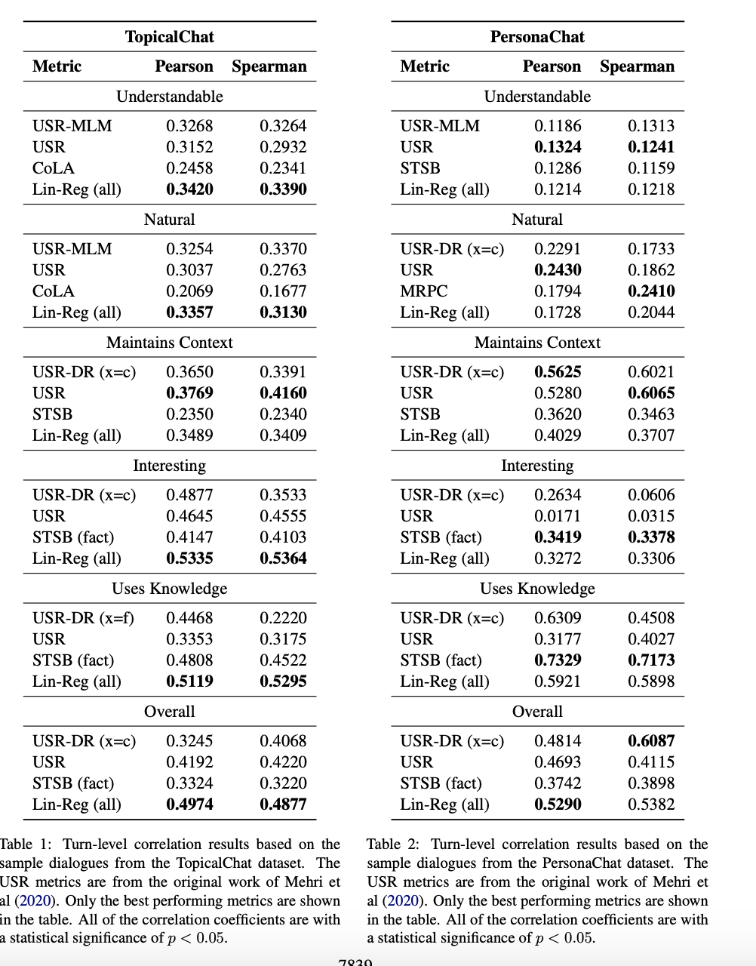

Slide 25
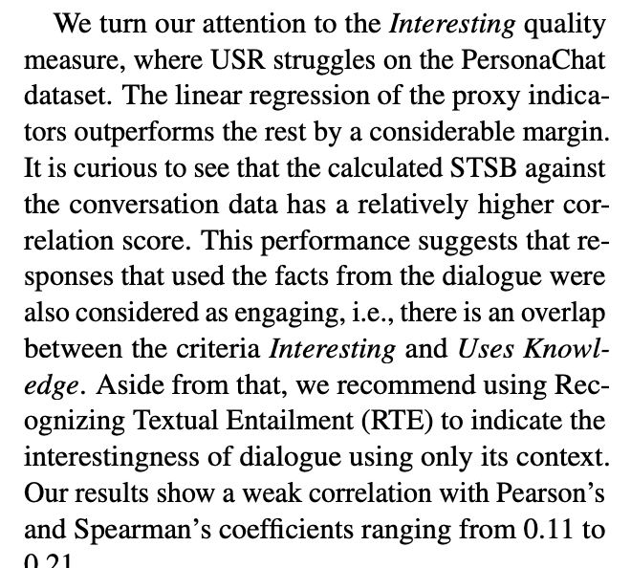

Slide 26
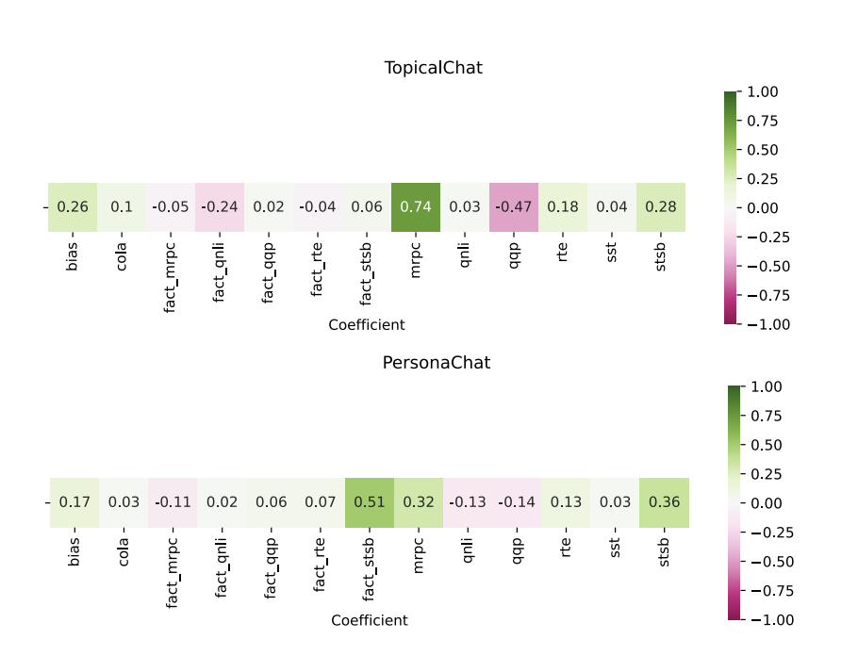

Slide 27
Synthesis
I’m not entirely sure what to think of this paper. 30-40% correlation seems fairly low. It’s an interesting line of research. I think it would be interesting to see examples where the model misclassified. I do like that this approach allows for “apples-to-apples” comparisons. The same fine-tuned bert models could evaluate many different dialogue systems given a set of prompts. However, it’s not clear to me that this is the best reward function- GLUE’s domain is limited in some ways. For example, grammatical mistakes made by foreign speakers might not be the same types of mistakes made by a dialogue system.

